Slide 1
Introduction to Databases Checkpoint
Realiser par : Kawthar jmaiel

Slide 2
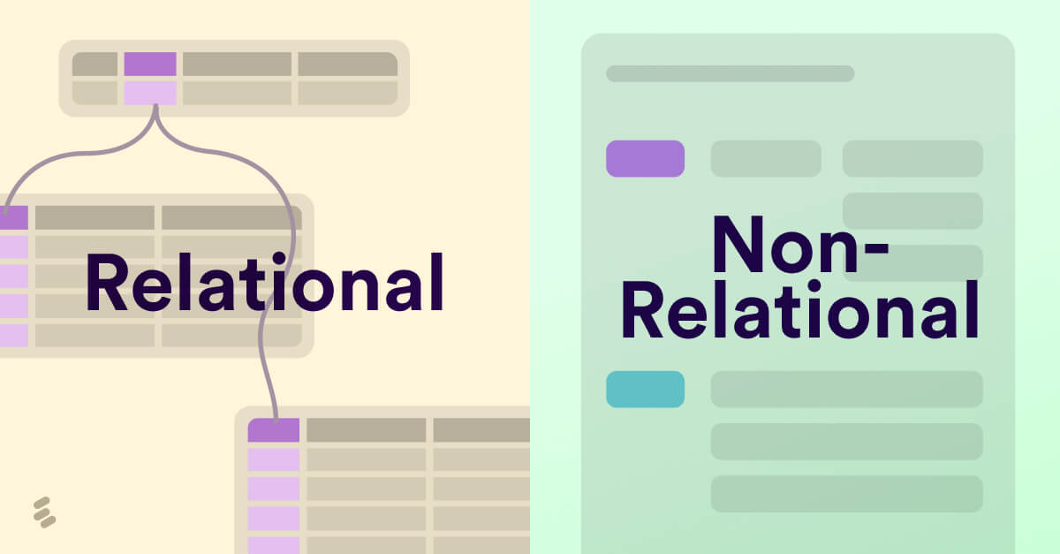
SQL vs NoSQL
First, let’s look into the difference between SQL and NoSQL databases. SQL stands for “structured query language”. Thus SQL databases use structured querying. NoSQL databases either use both, or only unstructured querying.
 | SQL | NoSQL
Query language | SQL | NoSQL
Data structure | Highly structured | Flexible structures/schemas
Data | Smaller, more stable data | Large, fast-changing data
Speed | Faster for single object queries or simple joins | Faster for specific query types, path traversals or multiple objects
Scalability | Vertically scalable | Horizontally scalable
Property followed | ACID | BASE (only few ACID)

Slide 3
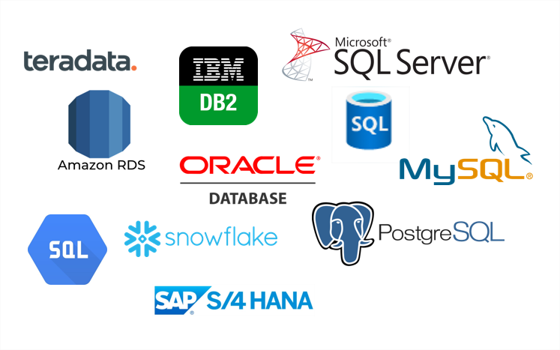
SQL databases
SQL databases are often also referred to as relational. While it is true that relational databases are SQL, not all SQL databases are relational. There are more kinds of databases that store data in a highly structured manner. SQL databases generally leverage tables and scale vertically. In other words, to scale those databases up, you need more powerful hardware. SQL databases are best suited for data that does not change often.

Slide 4
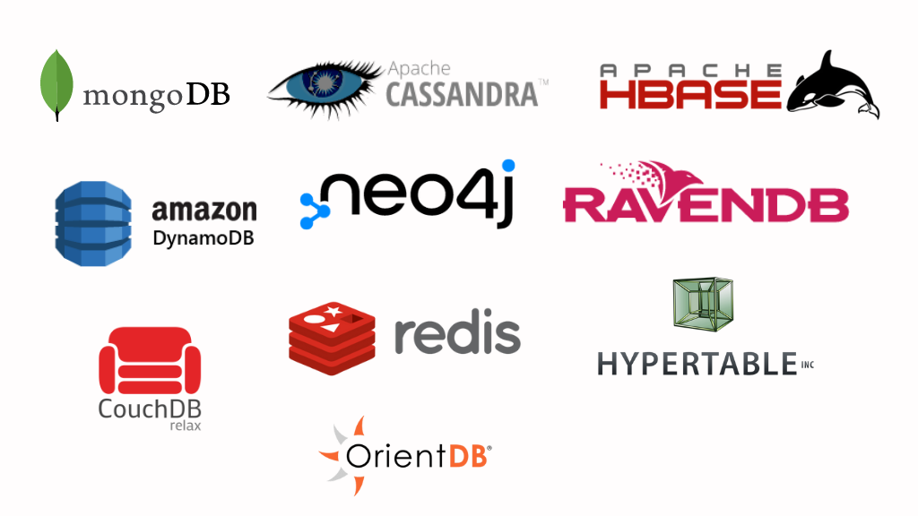
NoSQL databases
NoSQL databases are less structured. They have different, often flexible schemas that make them ideal for semi-structured data. These databases scale horizontally - they can scale by adding more machines. Horizontal scalability makes NoSQL databases ideal for large and fast-changing datasets.

Slide 5
MongoDB vs SQL Server: Which is Better?
Data in MongoDB is represented as a collection of JSON documents, whereas data in SQL is represented as tables and rows.
When it comes to querying, we must enter a string into the query language that the database system will parse. Structured Query Language is the name of the query language. On the other hand, MongoDB's querying is object-oriented, which means you provide MongoDB with a document that describes what you're looking for, and there is no parsing.
The Join command, which permits querying across multiple tables, is a significant advantage of SQL. On the other hand, MongoDB does not enable JOINS but instead supports multi-dimensional data types such as documents and arrays.
In SQL, we can have one document inside another. However, MongoDB allows us to have one array of comments and one collection of posts within a post.
SQL allows for atomic transactions. You can have many operations within a transaction and roll back as if they were all one operation. MongoDB does not handle transactions, and each operation is atomic.

Slide 6
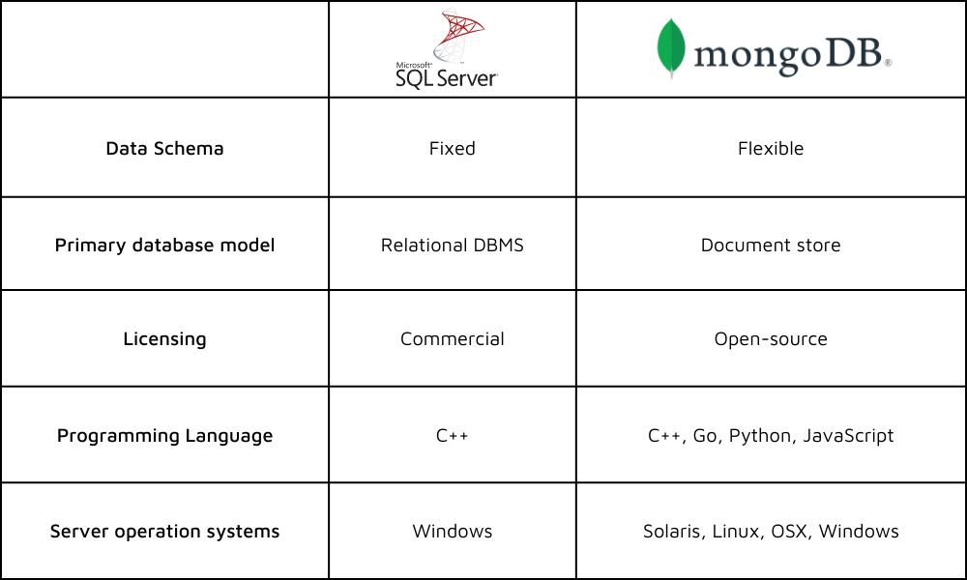
MongoDB vs SQL Server
We do not need to define the schema in MongoDB. We may simply drop the docs in. In the case of SQL, we must first define the tables and columns.
MongoDB lacks reporting tools, i.e., performance testing and analysis are not always possible, while SQL includes a number of reporting tools.

Slide 7

Features of MongoDB
MongoDB is a cross-platform, free, and open-source document-oriented database application. It is a NoSQL database tool that employs JSON-like documents with schemas
1) Document Oriented
2) Schema-less database
3) Scalability
4) Indexing
5) Aggregation
6) High Performance

Slide 8
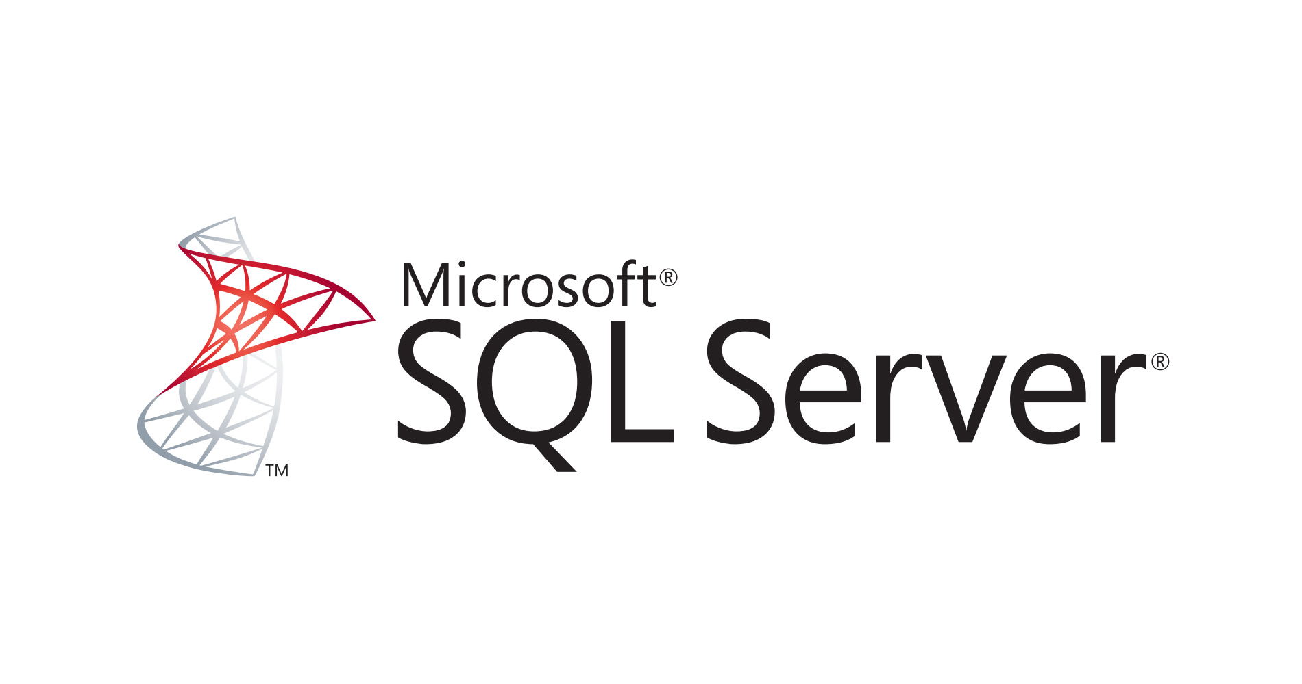
Features of SQL
SQL (Structured Query Language) is a domain-specific language developed for managing data stored in a Relational Database Management System (RDBMS). It is especially beneficial when dealing with structured data that contains relationships between multiple entities/variables of the data.
1) High Performance
2) High Availability
3) Scalability and Flexibility
4) Robust Technical Support
5) High Security
6) Comprehensive Application Development
7) Management Ease

